Slide 1








Database II
Entertainment
Group: GraphOutLoud
Atabek, Isil 2048715
Ashok Mayagappa, Prarthana 2051998 Sah, Annanya Ajay 2044007
Database 2
Master course in Computer Engineering

Slide 2
Domain
Youtube
Instagram
Entertainment
Twitter
Grammy Awards
Database 2
6

Slide 3
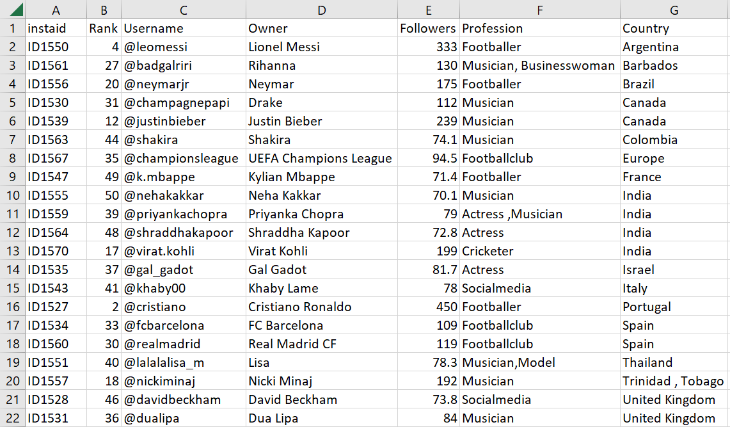
Domain
Youtube
Instagram
Top_50_Most_Followed_Instagram_Accounts
Entertainment
Twitter
Grammy Awards
Database 2
6

Slide 4
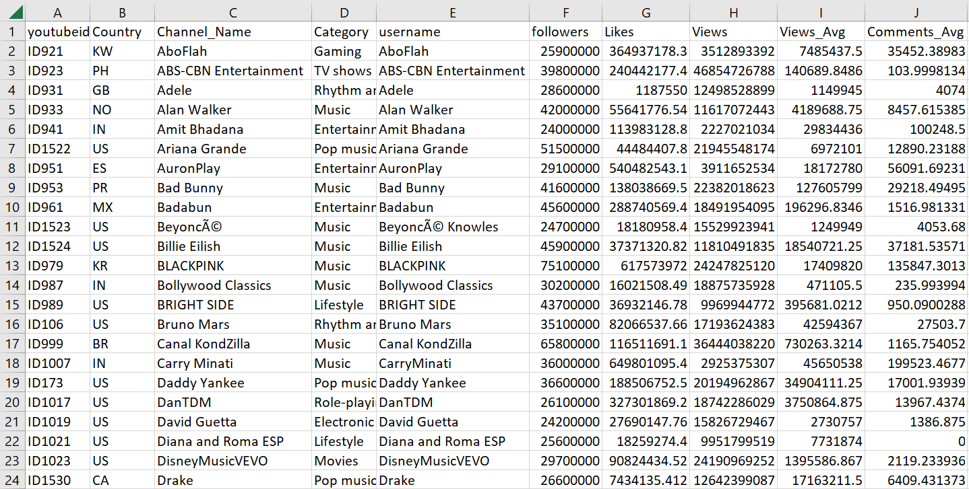
Domain
Top_200_youtubers
Youtube
Instagram
Top_50_Most_Followed_Instagram_Accounts
Entertainment
Twitter
Grammy Awards
Database 2
6

Slide 5
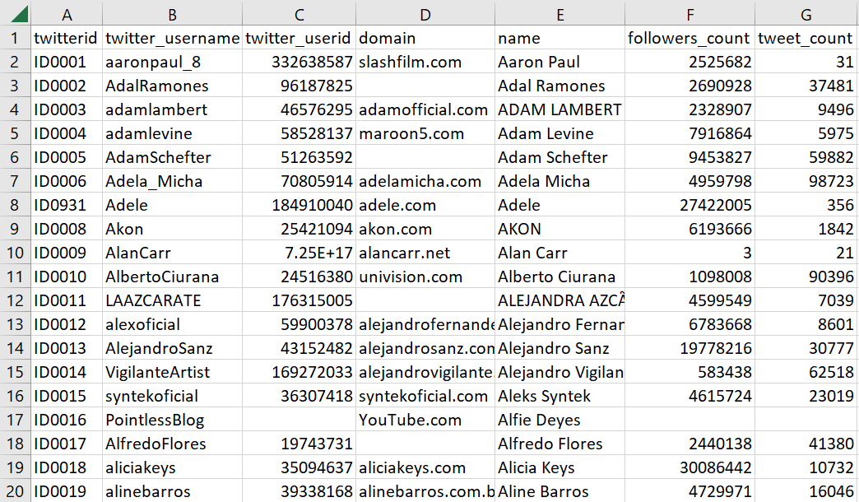
Domain
Top_200_youtubers
Youtube
Instagram
Top_50_Most_Followed_Instagram_Accounts
Entertainment
Twitter
Top_1000_Celebrity_Twitter_Accounts
Grammy Awards
Database 2
6

Slide 6
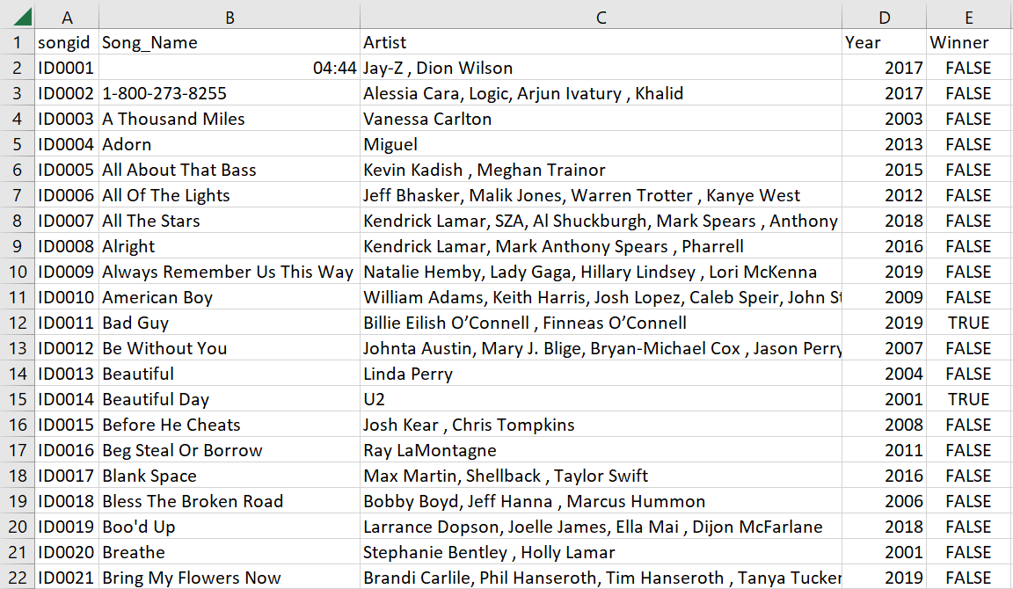
Domain
Top_200_youtubers
Youtube
Instagram
Top_50_Most_Followed_Instagram_Accounts
Entertainment
Twitter
Top_1000_Celebrity_Twitter_Accounts
Grammy Awards
Grammy_Award
Database 2
6

Slide 7
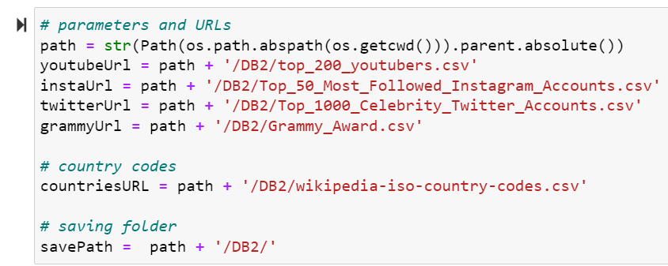
Data Cleaning and Serialisation
Database 2
6

Slide 8
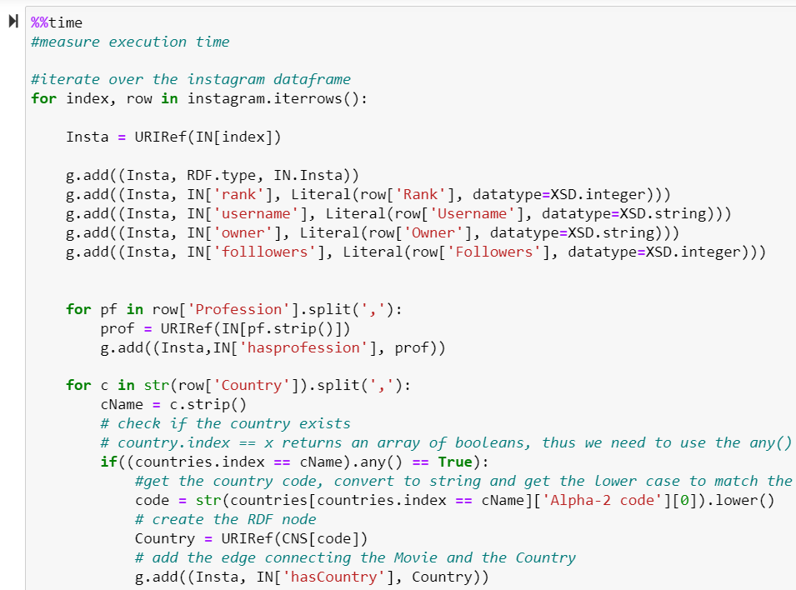
Data Cleaning and Serialisation
Database 2
6

Slide 9
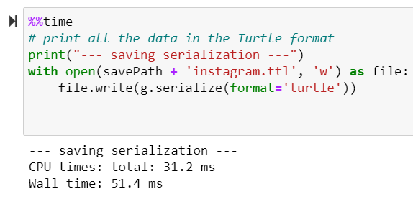
Data Cleaning and Serialisation
Database 2
6

Slide 10
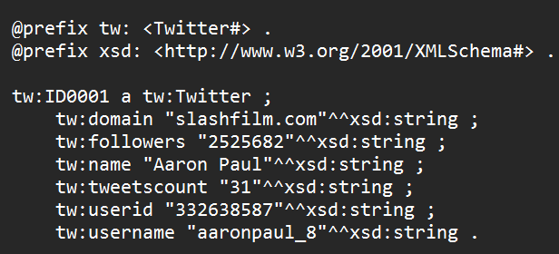
Data Cleaning and Serialisation
Database 2
6

Slide 11
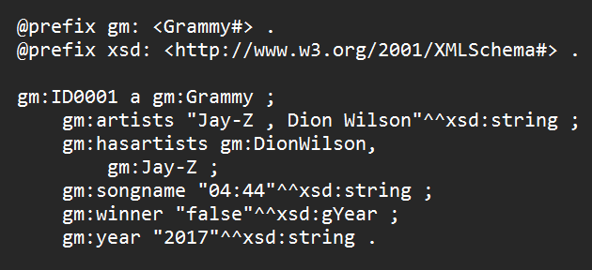
Data Cleaning and Serialisation
Database 2
6

Slide 12
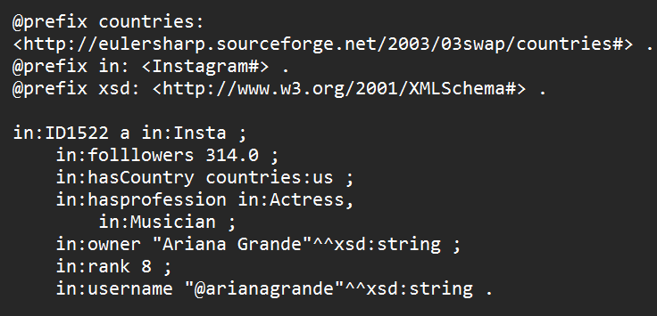
Data Cleaning and Serialisation
Database 2
6

Slide 13
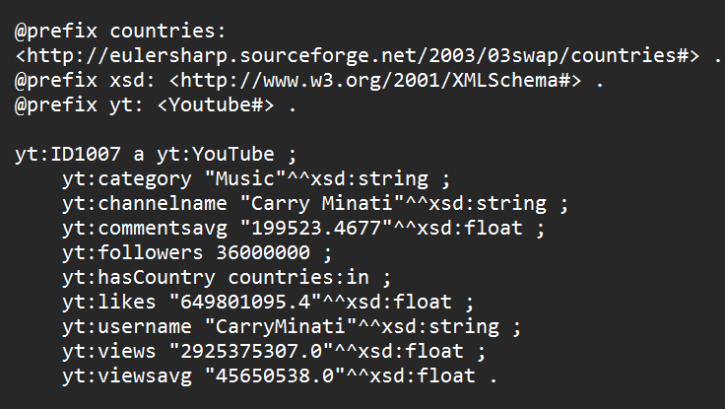
Data Cleaning and Serialisation
Database 2
6

Slide 14
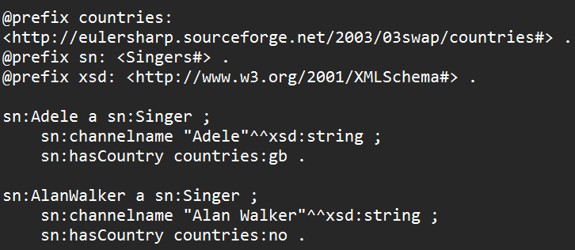
Data Cleaning and Serialisation
Database 2
6

Slide 15
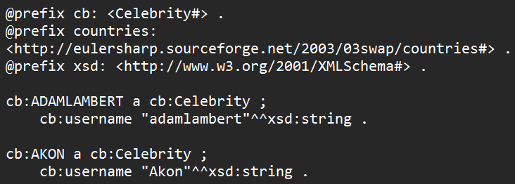
Data Cleaning and Serialisation
Database 2
6

Slide 16
Ontology Design
What is the domain that the ontology will cover?

Slide 17
Ontology Design
What is the domain that the ontology will cover?
Entertainment

Slide 18
Ontology Design
What is the domain that the ontology will cover?
Entertainment
For what we are going to use the ontology?

Slide 19
Ontology Design
What is the domain that the ontology will cover?
Entertainment
For what we are going to use the ontology?
To model celebrities, singers, social media accounts - music platforms, grammy awards.

Slide 20
Ontology Design
For what types of questions the information in the ontology should provide answers?

Slide 21
Ontology Design
For what types of questions the information in the ontology should provide answers?
Who are the top followed celebrities on twitter and instagram?
What is the number of followers of a given celebrity on twitter and instagram?
What is the rank of a given celebrity on instagram?
If a singer was nominated/awarded to grammy awards? And if so, on what year and to which song the award was given?
Where is a given celebrity is from?
Which celebrities have both instagram and twitter accounts?

Slide 22
Ontology Design
For what types of questions the information in the ontology should provide answers?
Who are the top followed celebrities on twitter and instagram?
What is the number of followers of a given celebrity on twitter and instagram?
What is the rank of a given celebrity on instagram?
If a singer was nominated/awarded to grammy awards? And if so, on what year and to which song the award was given?
Where is a given celebrity is from?
Which celebrities have both instagram and twitter accounts?
Who will use and maintain the ontology?

Slide 23
Ontology Design
For what types of questions the information in the ontology should provide answers?
Who are the top followed celebrities on twitter and instagram?
What is the number of followers of a given celebrity on twitter and instagram?
What is the rank of a given celebrity on instagram?
If a singer was nominated/awarded to grammy awards? And if so, on what year and to which song the award was given?
Where is a given celebrity is from?
Which celebrities have both instagram and twitter accounts?
Who will use and maintain the ontology?
Our ontology can be used by any people who are interested in our domain to analyse the relationships between the celebrities and social media accounts.

Slide 24
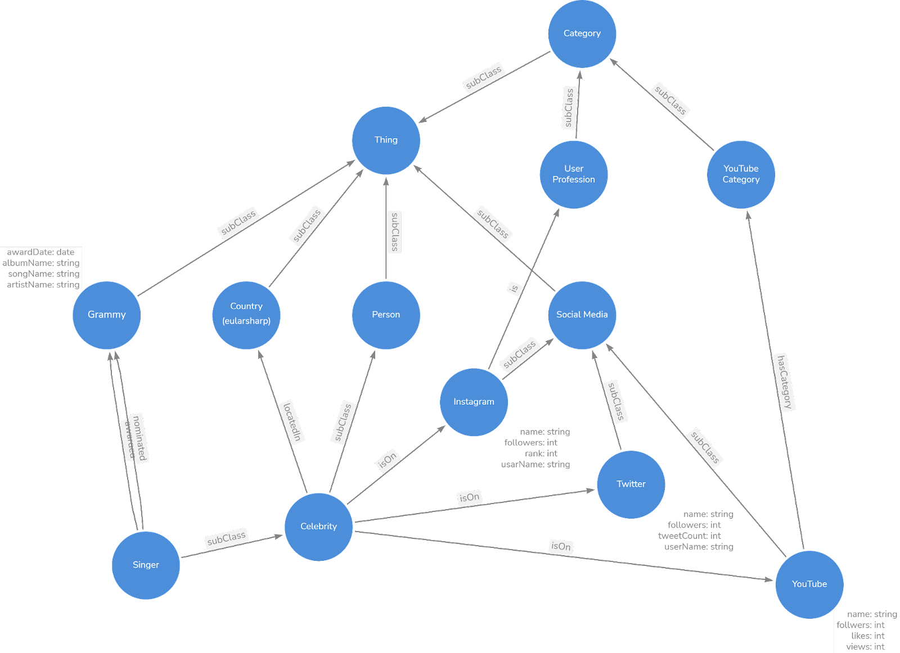
Ontology Graph

Slide 25
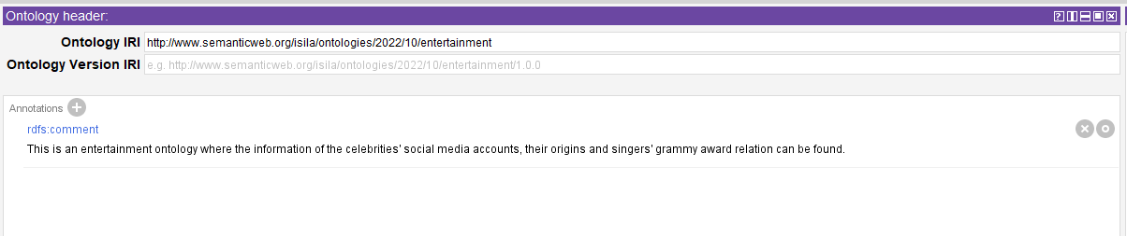
Protege

Slide 26
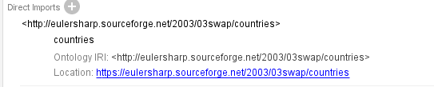
Protege

Slide 27
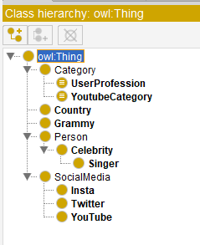
Protege - Classes

Slide 28

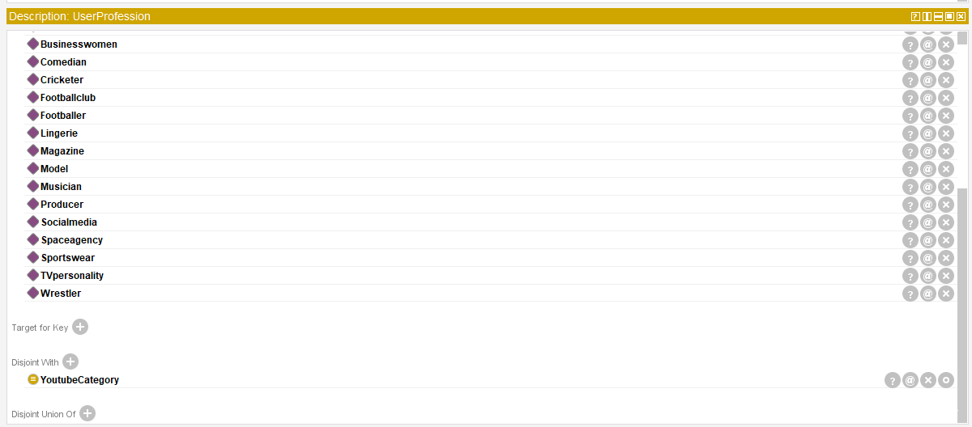
Protege - Classes

Slide 29
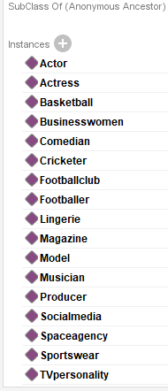

Protege - Classes

Slide 30
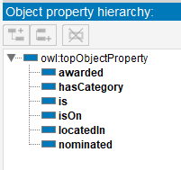
Protege - Object Properties

Slide 31
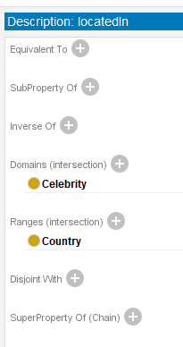
Protege - Object Properties

Slide 32
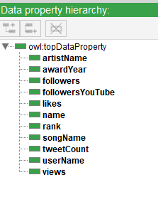
Protege - Data Properties

Slide 33
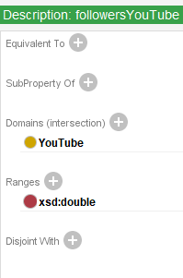
Protege - Data Properties

Slide 34
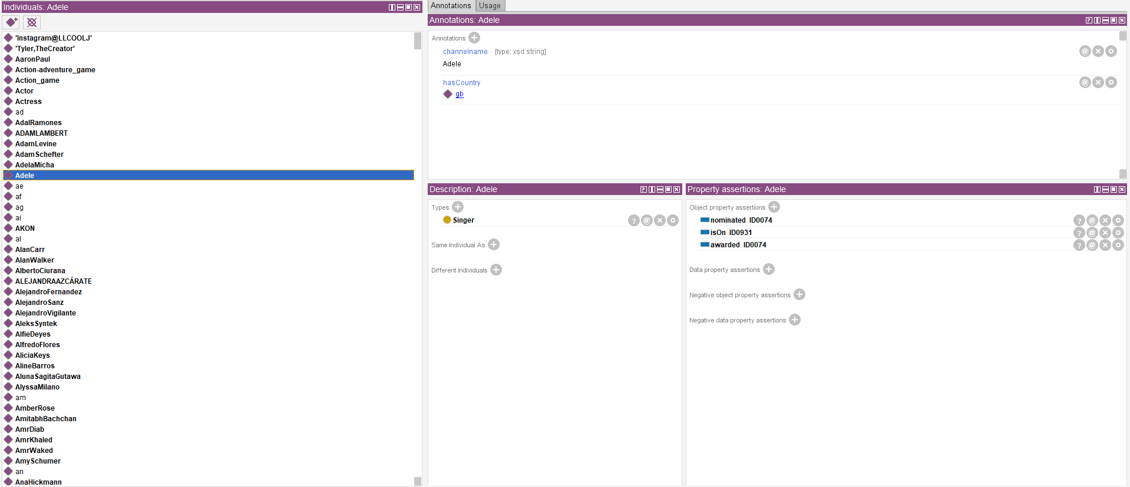
Protege - Individuals

Slide 35
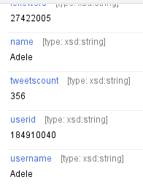
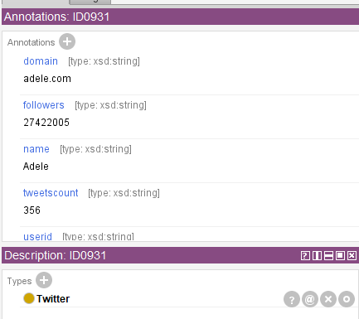
Protege - Individuals

Slide 36
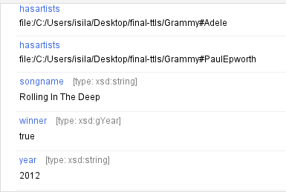
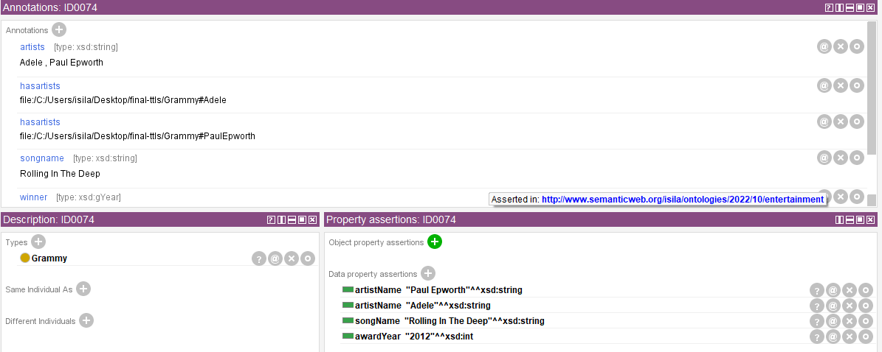
Protege - Individuals

Slide 37
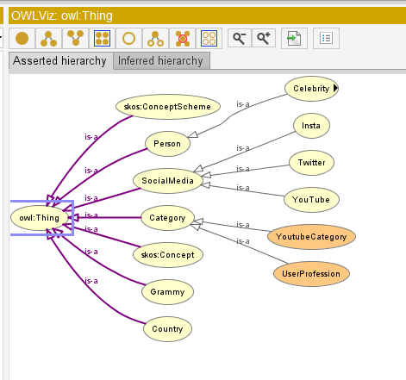

Protege - OWLViz

Slide 38
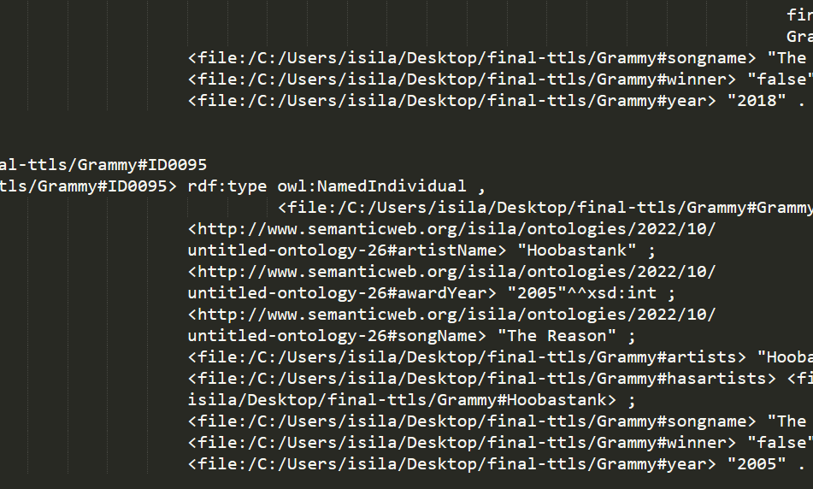
Protege - Ontology format
Turtle Syntax
Database 2
6

Slide 39
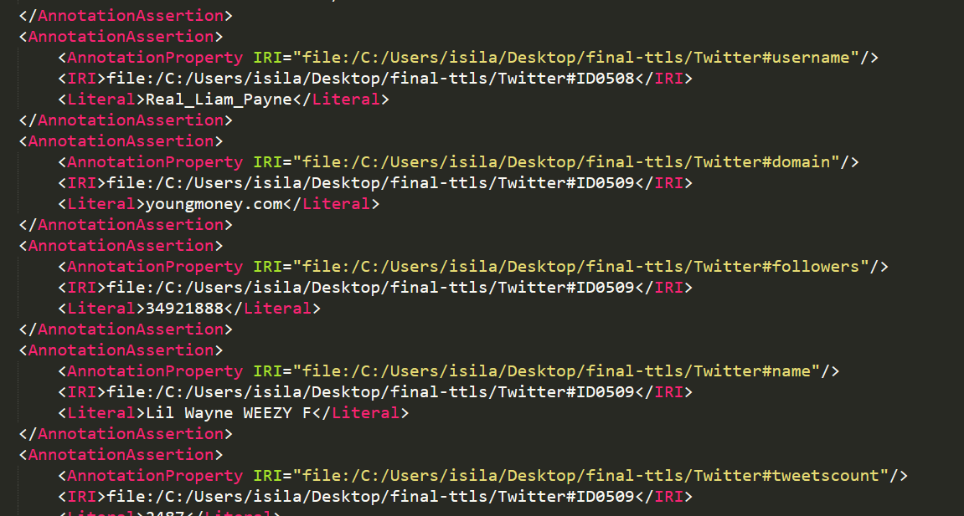
Protege - Ontology format
Turtle Syntax
OWL/XML Syntax
Database 2
6

Slide 40
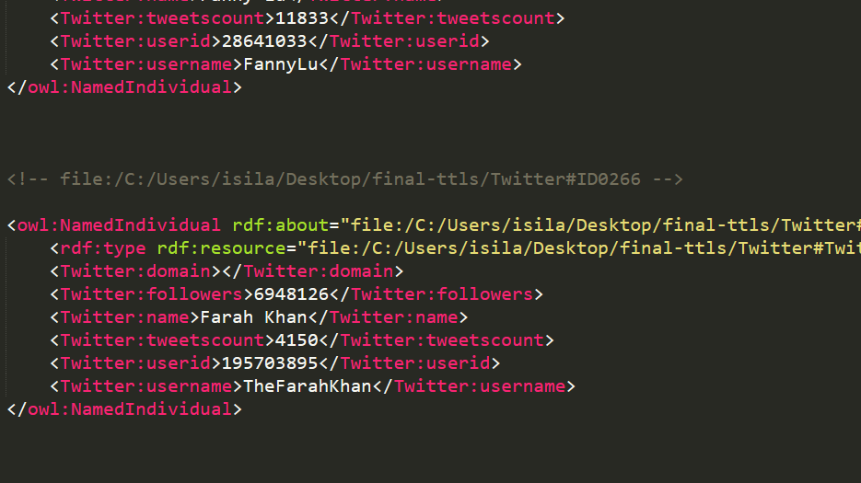
Protege - Ontology format
Turtle Syntax
OWL/XML Syntax
RDF/XML Syntax
Database 2
6

Slide 41
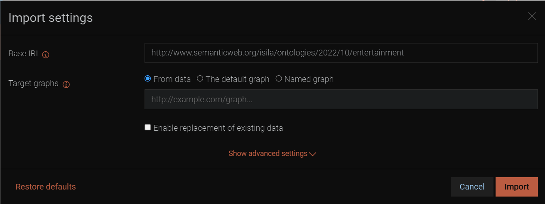
GraphDB data ingestion
Database 2
6

Slide 42
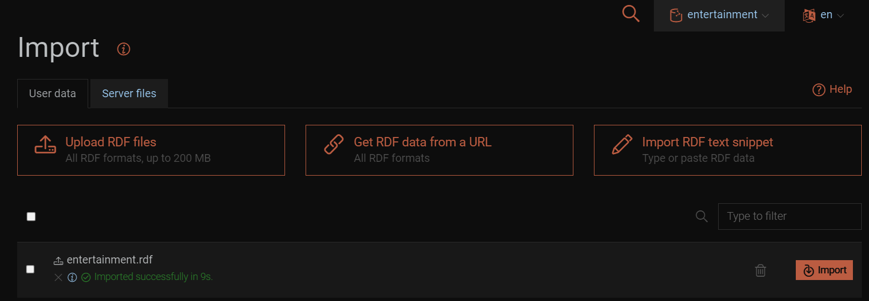
GraphDB data ingestion
Database 2
6

Slide 43
Prefixes
Database 2
6

Slide 44
Prefixes
PREFIX xsd: <http://www.w3.org/2001/XMLSchema#>
PREFIX Tw: <file:/C:/Users/isila/Desktop/final-ttls/Twitter#>
SELECT ?name ?followers
WHERE {
?s Twitter:name ?name .
?s Twitter:followers ?followers .
} ORDER BY DESC(xsd:integer(?followers)) LIMIT 50
Database 2
6

Slide 45
Prefixes
Gm: Grammy
Sg: Singer
Cb: Celebrity
Tw: Twitter
Ig: Instagram
Yt: Youtube
Database 2
6

Slide 46
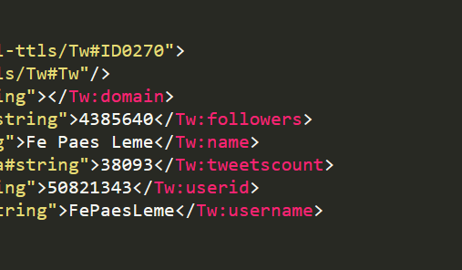
Prefixes
Gm: Grammy
Sg: Singer
Cb: Celebrity
Tw: Twitter
Ig: Instagram
Yt: Youtube
Database 2
6

Slide 47
Prefixes
Gm: Grammy
Sg: Singer
Cb: Celebrity
Tw: Twitter
Ig: Instagram
Yt: Youtube
PREFIX xsd: <http://www.w3.org/2001/XMLSchema#>
PREFIX Tw: <file:/C:/Users/isila/Desktop/final-ttls/Twitter#>
SELECT ?name ?followers
WHERE {
?s Tw:name ?name .
?s Tw:followers ?followers .
} ORDER BY DESC(xsd:integer(?followers)) LIMIT 50
Database 2
6

Slide 48
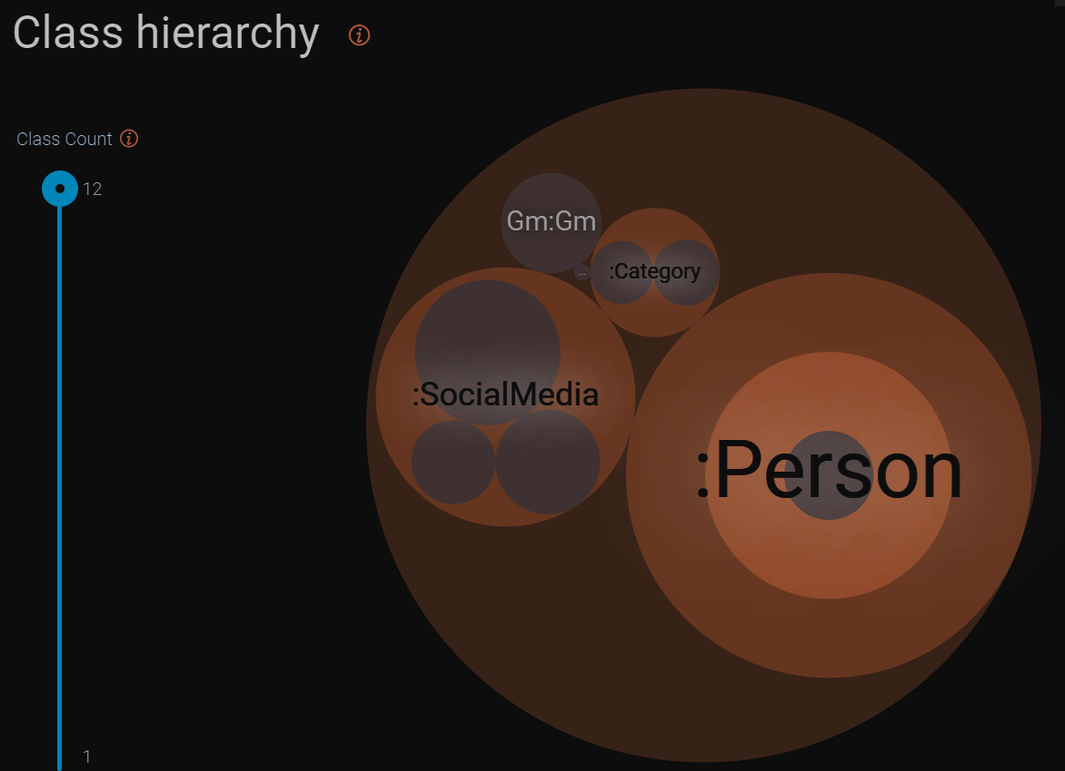
Class Hierarchy
Database 2
6

Slide 49
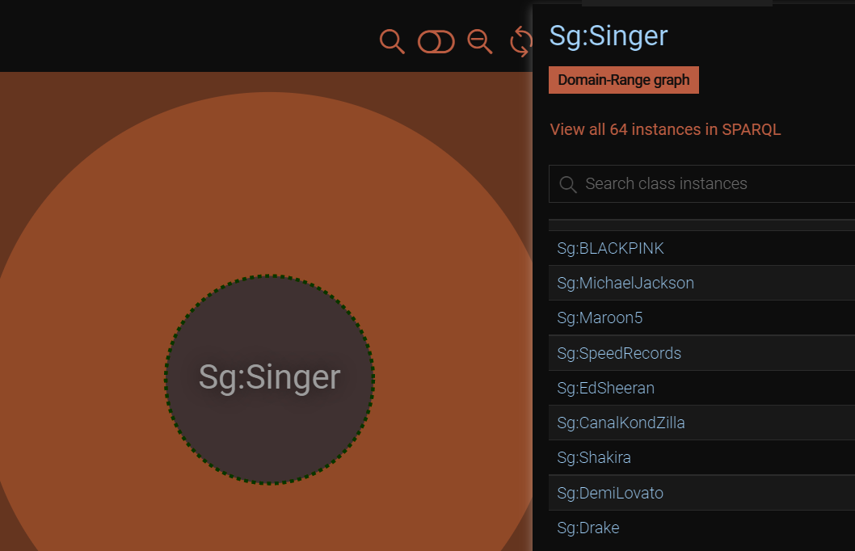
Class and Individuals
Database 2
6

Slide 50
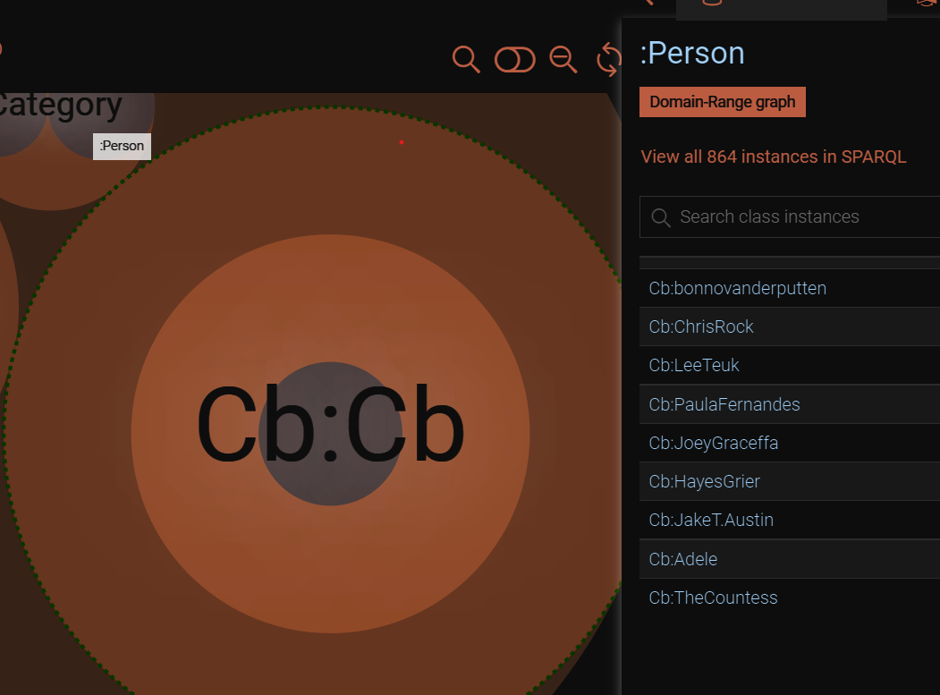
Class and Individuals
Database 2
6

Slide 51
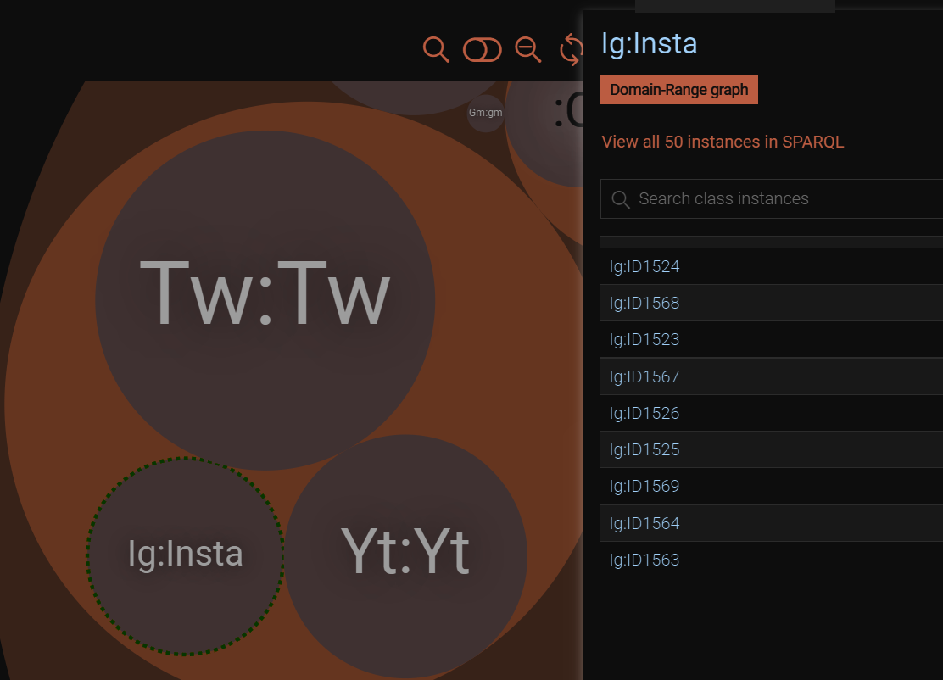
Class and Individuals
Database 2
6

Slide 52
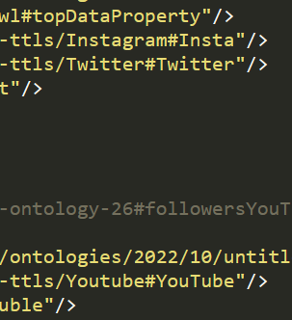
Class and Individuals
Database 2
6

Slide 53
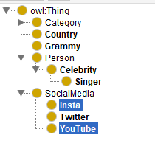
Class and Individuals
Database 2
6

Slide 54
Class and Individuals
Database 2
6

Slide 55
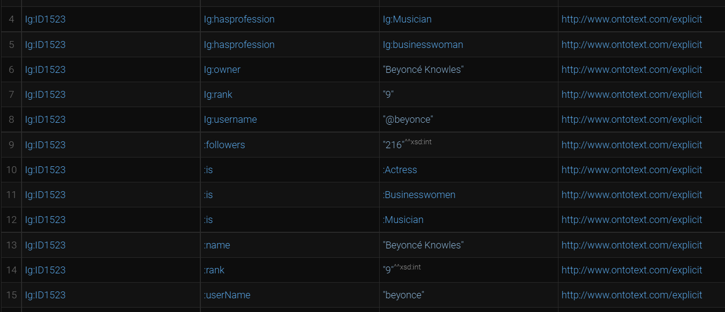
The triples
Database 2
6

Slide 56
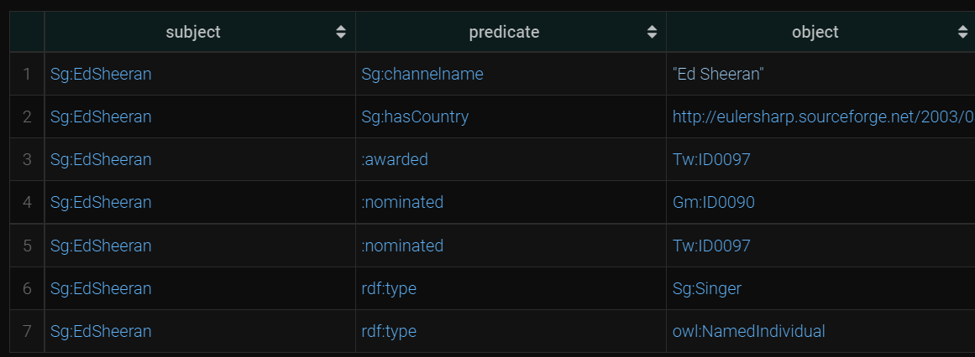
The triples
Database 2
6

Slide 57
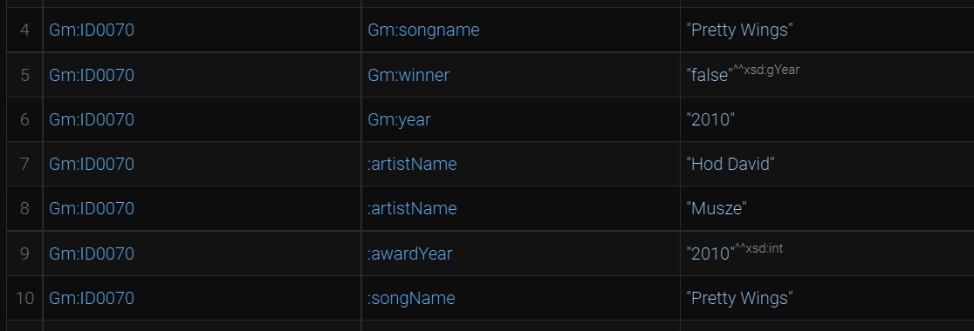
The triples
Database 2
6

Slide 58
SPARQL
1) Top 50 followed Twitter accounts
PREFIX xsd: <http://www.w3.org/2001/XMLSchema#>
PREFIX Tw: <file:/C:/Users/isila/Desktop/final-ttls/Tw#>
SELECT ?name ?followers
WHERE {
?s Tw:name ?name .
?s Tw:followers ?followers .
} ORDER BY DESC(xsd:integer(?followers)) LIMIT 50
Database 2
6

Slide 59
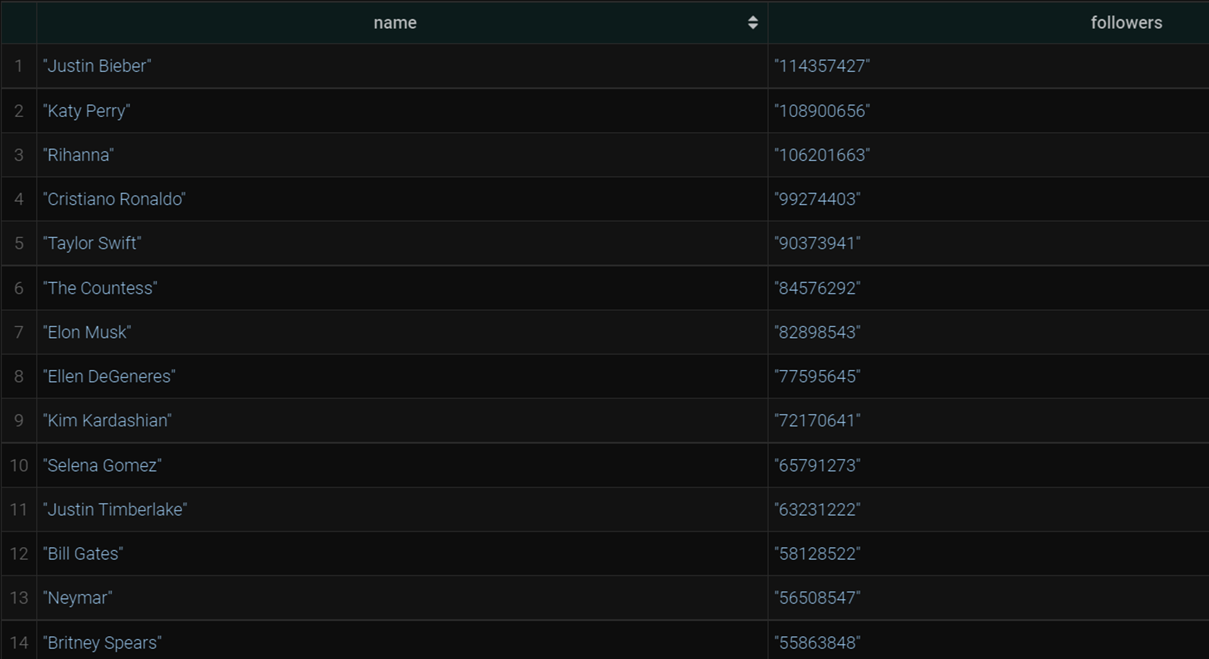
SPARQL
1) Number of followers in order on Twitter
PREFIX xsd: <http://www.w3.org/2001/XMLSchema#>
PREFIX Tw: <file:/C:/Users/isila/Desktop/final-ttls/Tw#>
SELECT ?name ?followers
WHERE {
?s Tw:name ?name .
?s Tw:followers ?followers .
} ORDER BY DESC(xsd:integer(?followers)) LIMIT 50
Database 2
6

Slide 60
SPARQL
2) Grammy winning songs from 2017 and 2019
PREFIX xsd: <http://www.w3.org/2001/XMLSchema#>
PREFIX Gm: <file:/C:/Users/isila/Desktop/final-ttls/Gm#>
select ?songname ?artists
where {
?s Gm:songname ?songname;
Gm:year ?year;
Gm:artists ?artists;
Gm:winner ?winner .
FILTER((?year="2017" || ?year="2019") && ?winner="true"^^xsd:gYear)
}
Database 2
6

Slide 61
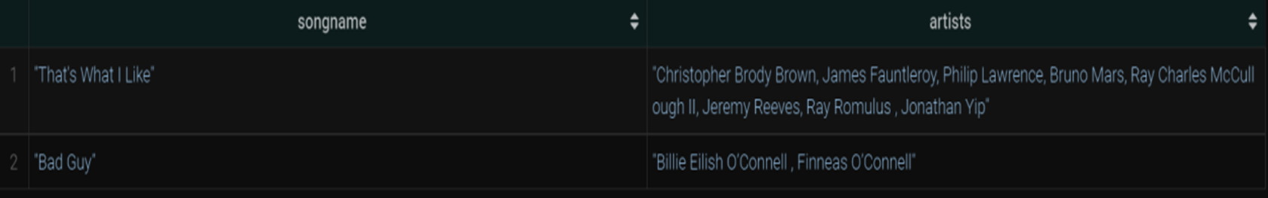
SPARQL
2) Grammy winning songs from 2017 and 2019
PREFIX xsd: <http://www.w3.org/2001/XMLSchema#>
PREFIX Gm: <file:/C:/Users/isila/Desktop/final-ttls/Gm#>
select ?songname ?artists
where {
?s Gm:songname ?songname;
Gm:year ?year;
Gm:artists ?artists;
Gm:winner ?winner .
FILTER((?year="2017" || ?year="2019") && ?winner="true"^^xsd:gYear)
}
Database 2
6

Slide 62
SPARQL
3) Rank in terms of max number of followers on Instagram
PREFIX Ig: <file:/C:/Users/isila/Desktop/final-ttls/Ig#>
PREFIX xsd: <http://www.w3.org/2001/XMLSchema#>
select ?owner ?rank ?followers ?profession
where {
?s Ig:owner ?owner;
Ig:rank ?rank;
Ig:folllowers ?f;
Ig:hasprofession ?profession .
BIND(CONCAT(STR( ?f ), " M") AS ?followers ) .
} ORDER BY(xsd:integer(?rank))
Database 2
6

Slide 63
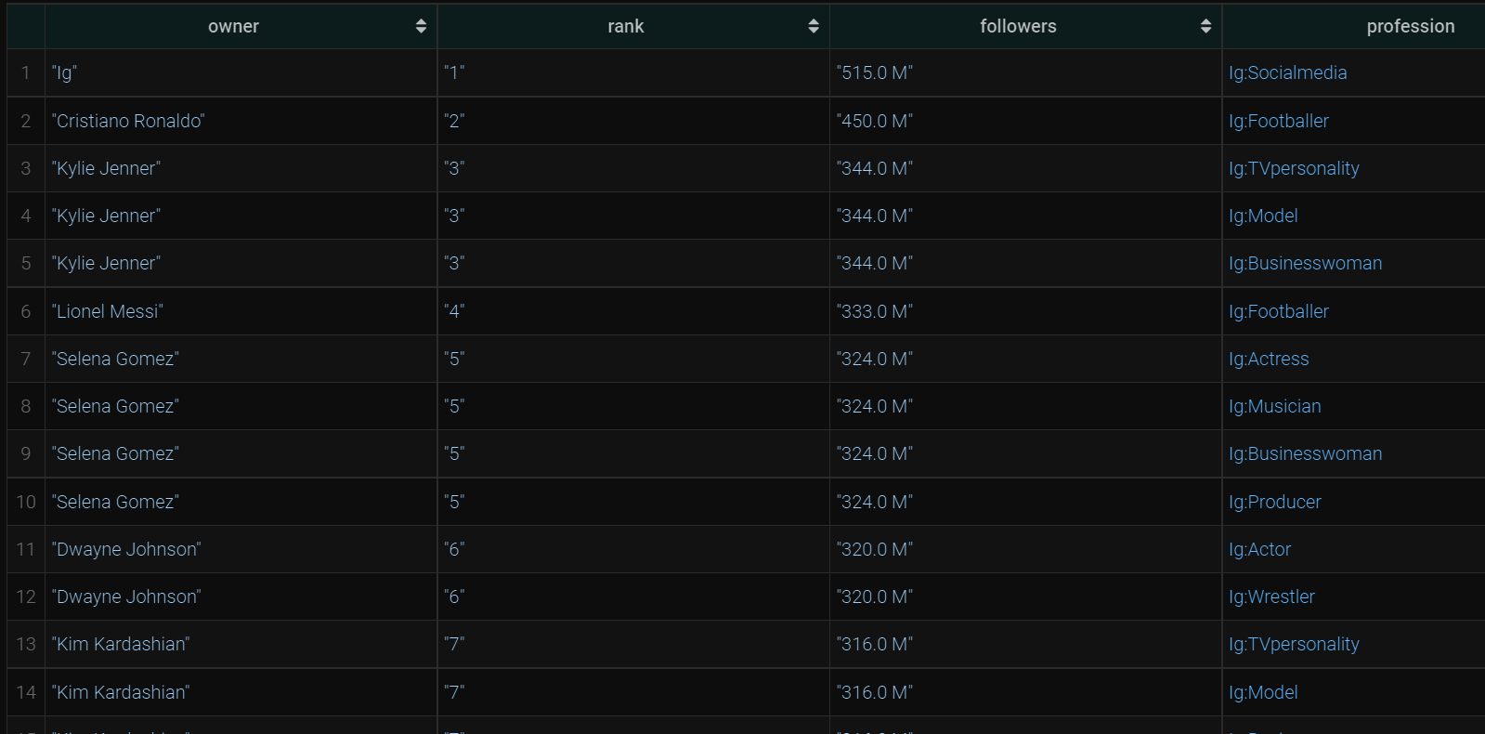
SPARQL
3) Rank in terms of max number of followers on Instagram
PREFIX Ig: <file:/C:/Users/isila/Desktop/final-ttls/Ig#>
PREFIX xsd: <http://www.w3.org/2001/XMLSchema#>
select DISTINCT ?owner ?rank ?followers ?profession
where {
?s Ig:owner ?owner;
Ig:rank ?rank;
Ig:folllowers ?f;
Ig:hasprofession ?profession .
BIND(CONCAT(STR( ?f ), " M") AS ?followers ) .
} ORDER BY(xsd:integer(?rank))
Database 2
6

Slide 64
SPARQL
4) List of specific categories of Youtube channels by order
PREFIX xsd: <http://www.w3.org/2001/XMLSchema#>
PREFIX : <http://www.semanticweb.org/isila/ontologies/2022/10/untitled-ontology-26#>
PREFIX Yt: <file:/C:/Users/isila/Desktop/final-ttls/Yt#>
select ?category ?channelName ?followers
where {
?s Yt:category ?category;
Yt:channelname ?channelName; Yt:followers ?followers .
FILTER(?category= "Music" || ?category="Hip hop music")
} ORDER BY(?channelName)
Database 2
6

Slide 65
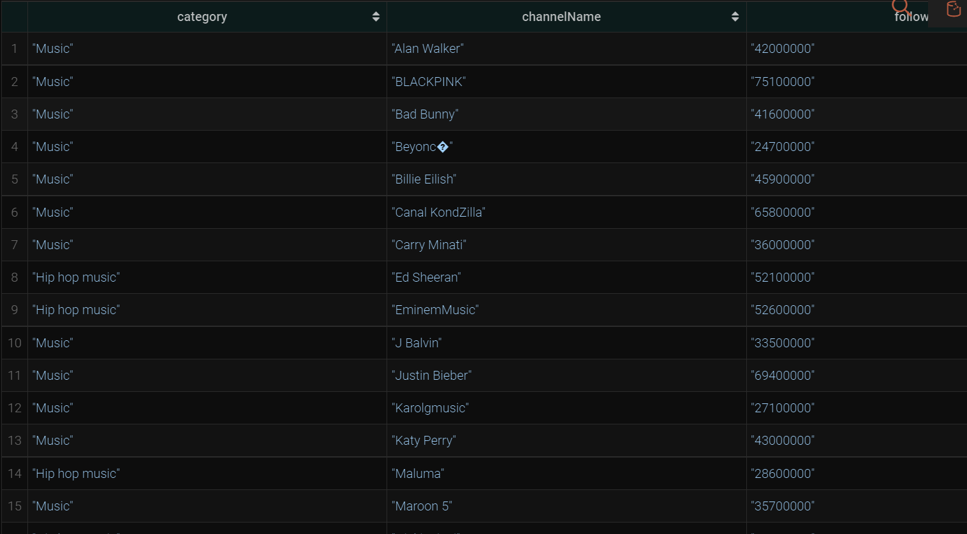
SPARQL
4) List of categories of Youtube channels by order
PREFIX xsd: <http://www.w3.org/2001/XMLSchema#>
PREFIX : <http://www.semanticweb.org/isila/ontologies/2022/10/untitled-ontology-26#>
PREFIX Yt: <file:/C:/Users/isila/Desktop/final-ttls/Yt#>
select ?category ?channelName ?followers
where {
?s Yt:category ?category;
Yt:channelname ?channelName; Yt:followers ?followers .
FILTER(?category= "Music" || ?category="Hip hop music")
} ORDER BY(?channelName)
Database 2
6

Slide 66
SPARQL
5) Singer and his/her country of birth
PREFIX Sg: <file:/C:/Users/isila/Desktop/final-ttls/Sg#>
select ?singer ?countryName
where {
?singer Sg:hasCountry ?country .
BIND(strafter(str(?country), '#') AS ?countryName).
FILTER(str(?countryName)="gb")
}
Database 2
6

Slide 67
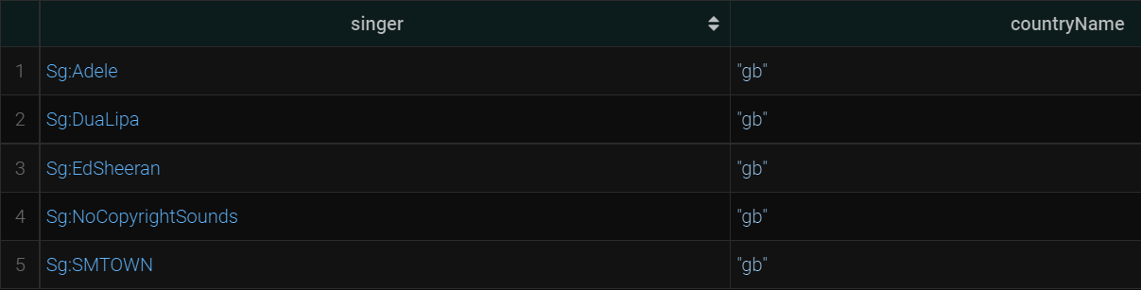
SPARQL
5) Singer and his/her country of birth
PREFIX Sg: <file:/C:/Users/isila/Desktop/final-ttls/Sg#>
select ?singer ?countryName
where {
?singer Sg:hasCountry ?country .
BIND(strafter(str(?country), '#') AS ?countryName).
FILTER(str(?countryName)="gb")
}
Database 2
6

Slide 68

SPARQL
Database 2
6

Slide 69
Thank You!
Database 2
6

